Slide 1
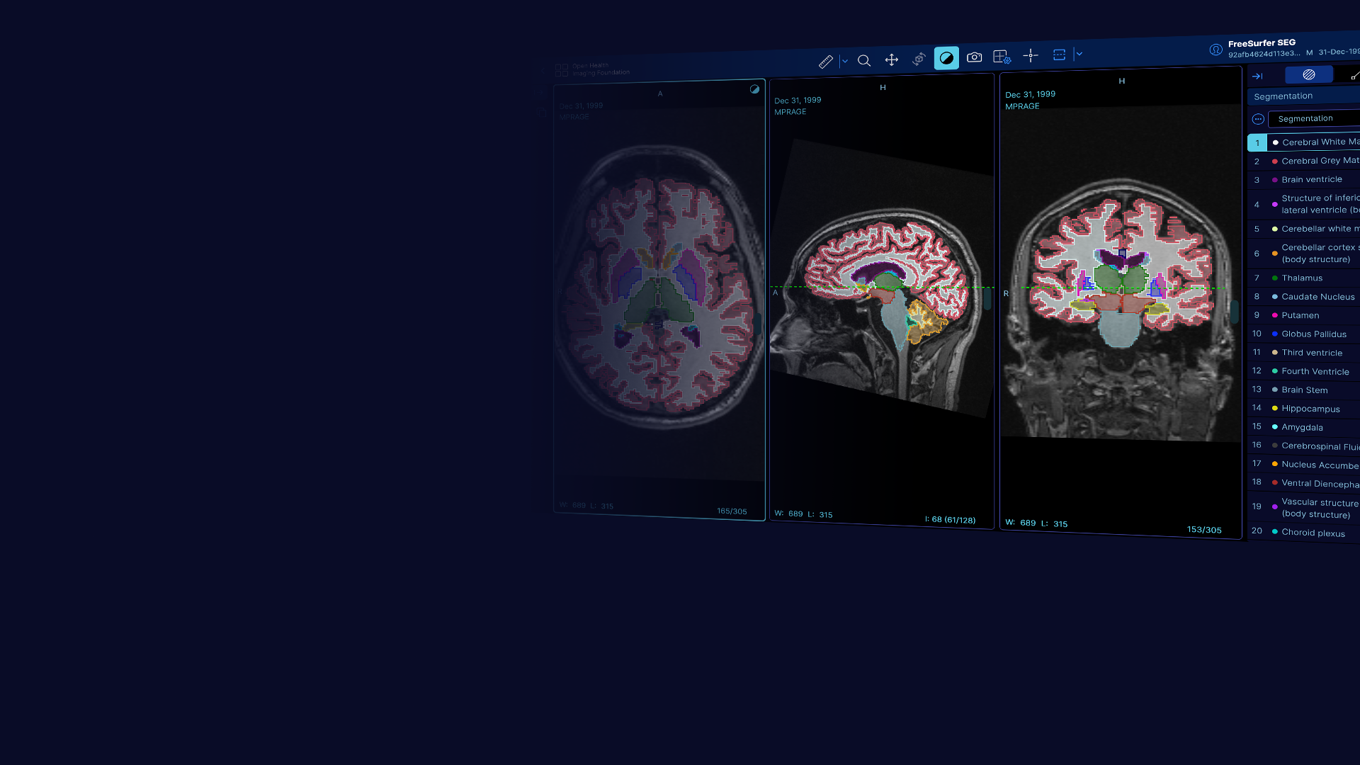



Advisory Board Meeting
February 13th, 2026

Slide 2
Community Metrics
4k stars on GitHub
OHIF and Cornerstone represent 7 of top 10 NCI-ITCR tagged libraries on Github
#1 active medical-imaging project on GitHub
189 GitHub contributors
Over 1,400 Slack members
Over 1,300 newsletter subscribers

Slide 3
Adoption
Academic
Industry
NCI Imaging Data Commons (IDC)
National Institute of Biomedical Imaging and Bioengineering (NIBIB)
NHLBI BioData Catalyst
NIAID Tuberculosis Portal / Depot
NCI Early Detection Research Network's archive service (LabCAS)
The Cancer Imaging Archive (TCIA)
Google funded integration with Cloud Healthcare API
OHIF integration with AWS Healthlake
Microsoft DICOMweb Server includes OHIF by default
Siemens integration with teamplay platform
NVIDIA MONAI includes OHIF for web
Startups
Yunu, Gradient Health, Pixilib Viz.ai, New Lantern, FlyWheel, Pliny, Detect-ED-X, Ascend, VUNO, Infervision and more
Institute for Systems Biology Cancer Genomics Cloud
eXtensible Neuroimaging Archive Toolkit (XNAT)
Osirix Foundation's Kheops Image Sharing platform
DKFZ Joint Imaging Platform and d:cipher (11 sites)
FUBerlin
QIPCM
ARPA-H Medical Imaging and Data Resource Center (MIDRC)

Slide 4
Current Funding
NIH Informatics Technology for Cancer Research (ITCR) U24
Five year sustainment grant through 2028
Year 4 begins May 2026
~$335k direct cost/year to cover development (0.8 FTE per year)
Eligible to apply for ~$62k additional set-aside funding each grant year
Prior set-aside collaborations include: Wash U pre-clinical 4D mode, UW eContour upgrade
2 year combined set-aside collaboration with FU Berlin currently pending award
NIH R03
Two year grant through August 2027
~$142k direct cost/year to cover development, testing, and docs (0.5 FTE per year)

Slide 5
Current Grant Year Summary
April 2025: 3.10
Expanded labelmap segmentation tool suite
Key features: SAM tool, one-click GPU-accelerated segmentation, undo/redo
August 2025: 3.11
Added multi-modality utility tools
Key features: Viewport fusion UI, RT Dose overlay, multi-planar RTSS visualization, lung ultrasound mode
February 2026: 3.12
Added contour tool suite
Key features: Freehand, livewire, spline, and sculpt tools, logical operations (combine and modify contours), unified contour and labelmap segmentation panel
OHIF Governance Framework released

Slide 6
OHIF 3.13 Roadmap
Stabilization and optimization of segmentation suite
FHIR PACS integration
New study list design
Migration to UI-next component library
Community-driven fixes:
Rendering performance
Calibration and measurement update
Improved security patching process

Slide 7
Discussion
Indication from the community is that OHIF needs to catch up on quality and stability after a heavy focus on feature expansion.
Currently, the focus of OHIF 3.13 is stability and optimization, with the only new features being those with low impact to core architecture
Stability and quality will be a long term focus, extending beyond the next version
Questions remain:
How can we sustainably expand OHIF’s feature suite without incurring additional technical debt, given the limited resourcing availability?
How can we ease the community burden of upgrading OHIF versions, and reduce the number of projects that decide to fork OHIF rather than stay current?
What additional materials/guidance would you like to see provided with each OHIF release?
If your teams have experiences related to this, please share!

